Slide 1
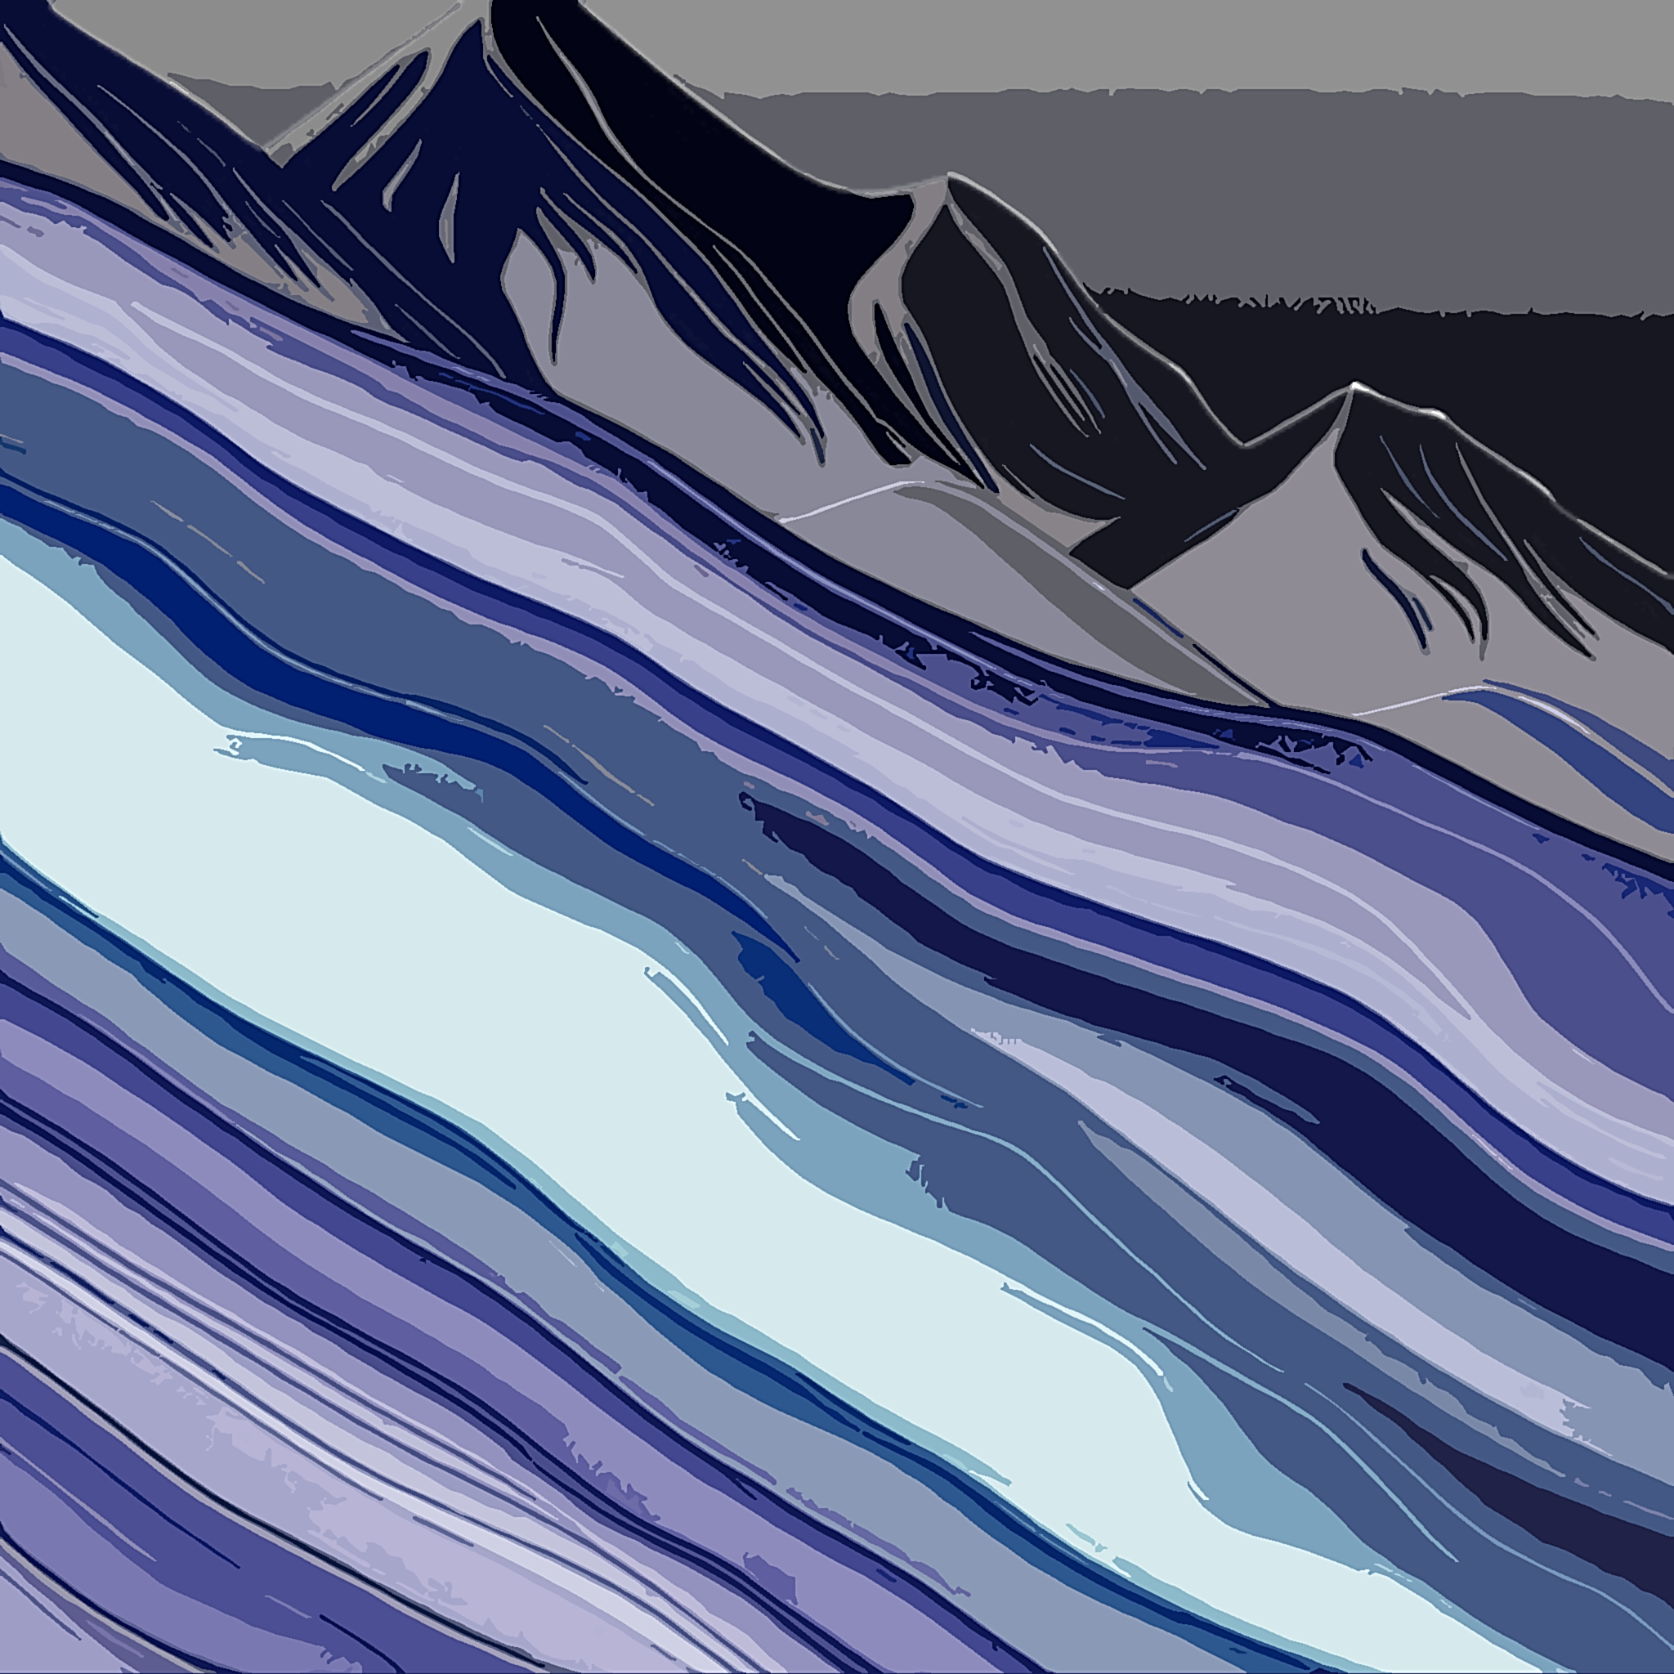
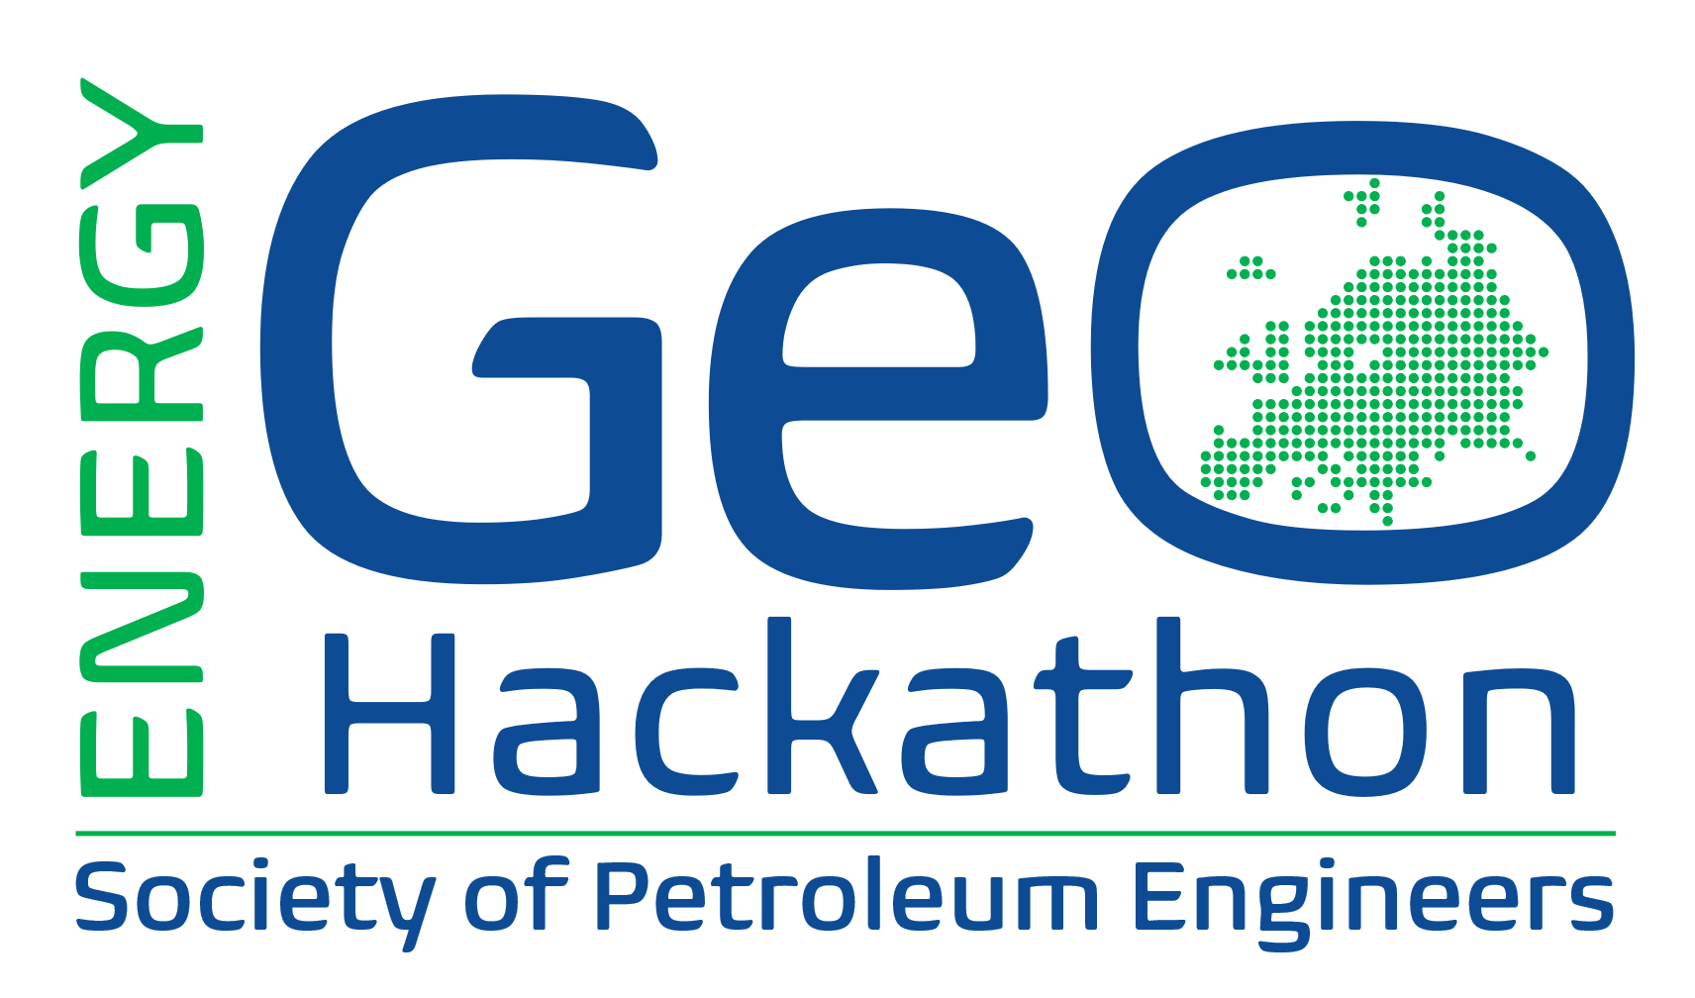










#DatafyingEnergy
From October 21, 2024
2024 SPE Europe Energy GeoHackathon
www.spehackathon-eu-com

Slide 2


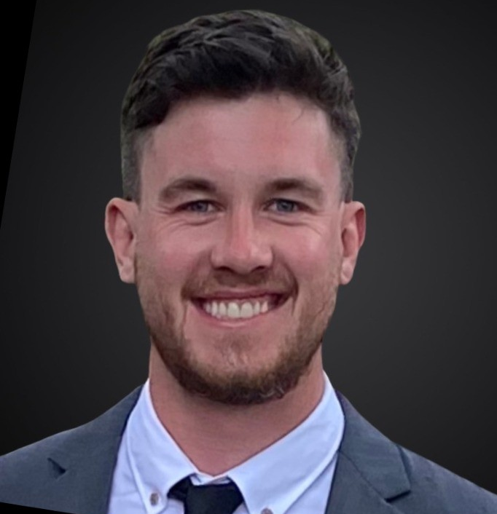










#DatafyingEnergy
21st October 2024 – 18th December 2024
#6 Leapfrog Overview: Building a Conceptual Model
Josh Sellars
Project Geophysicist – Energy
is a Geophysicist based in Vancouver, Canada, and specializes in geophysical processing, interpretation, and geological modelling for Energy exploration and feasibility studies. He holds a Bachelor’s in Geophysics from Memorial University. Josh has extensive experience using Leapfrog for Geothermal and Hydrocarbon exploration projects, using Leapfrog’s dynamic model building tools for early-stage exploration and structural interpretation to create a conceptual model of the subsurface. Integration and management of data from multiple fields of geoscience is key to developing a holistic understanding of the subsurface, which is Josh’s main focus using Seequent’s suite of products. Josh joined Seequent in 2017 and is based in Vancouver, Canada. In his current role as Project Geophysicist he contributes to Training, Support, and Technical advice to Oasis montaj and Leapfrog users in North America.
www.spehackathon-eu.com

Slide 3
The Challenge - Introduction
This year, the challenge for the SPE Europe GeoHackathon will be to use a dataset from Croatia.
The aim is to use machine learning to predict reservoir properties for two new wells, using well and seismic data from 6 other, already existing wells.
This information will then be the basis, to generate a geothermal field development plan, to generate electricity for a town of 50,000 people.
3

Slide 4
Deliverables
Deliver a readable and workable code, with sufficient comments, so that the judges can reproduce your results
Prepare a short (4 page) high level management report covering both parts of the challenge
For the data analytics, describe what you did, how you did it, how good are results
For the FDP, what are your main assumptions and risks, how much electricity do you generate with the costs.
Make a 5 min video presentation of the project
4

Slide 5
Data Review
Map
Seismic lines
Petrophysical data
Gamma Ray
Porosity
Permeability
Well Coordinates
Lithologies
Geothermal Gradients
Software available:
Leapfrog
Python
Excel (forecast and economics)
Other software that you have available
5

Slide 6
Data Handling
Use Leapfrog for visualizing the well and seismic data
Use Python to generate the algorithms and code to carry out the data analytics and carry out prediction of reservoir properties
6

Slide 7
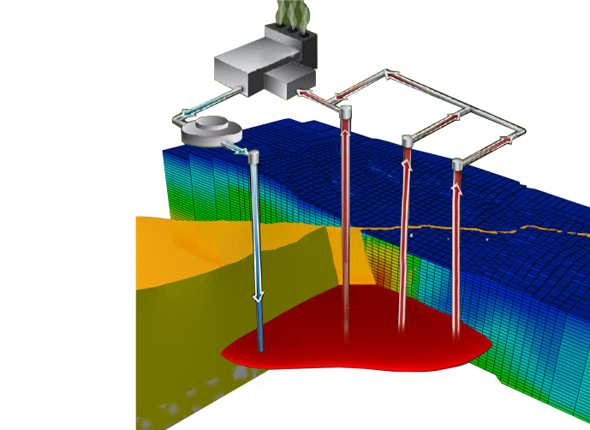





World-leading coupled modeling software
to address the challenges of Geothermal Assets
Links subsurface model to surface via wellbore models
Forecast power generation and injection load from surface network model
Conceptual Model linked to Reservoir Model
7
7
© 2024 Seequent, The Bentley Subsurface Company

Slide 8
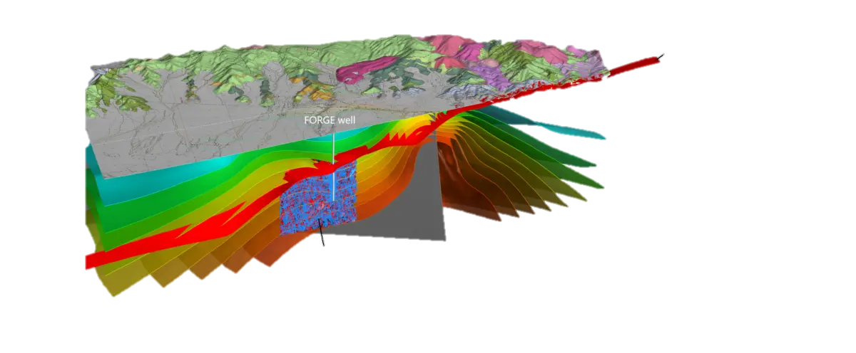

Seequent is providing Leapfrog Energy 3D geomodeling software licenses for the GeoHackathon
Leading software used by geothermal operators worldwide to model the subsurface, understand risk, and plan and operate their resource
Your teams will have access to Leapfrog to:
Build a 3D conceptual model of the geothermal system by combining and interpreting geological and geophysical data
QA/QC of ML-derived properties & update geo model
Visualize and present results
Temperature distribution & fracture network Utah FORGE Milford site
Case Studies
Note: Leapfrog licenses are personal, non-transferable, and non-exclusive and use is restricted to the hackathon only. You must not use the software for any commercial purposes. By accessing and using the software, you agree to the User Terms (https://www.seequent.com/legal-privacy/online-services-user-terms). Any information you provide will be managed and used in accordance with our Privacy Policy.

Slide 9
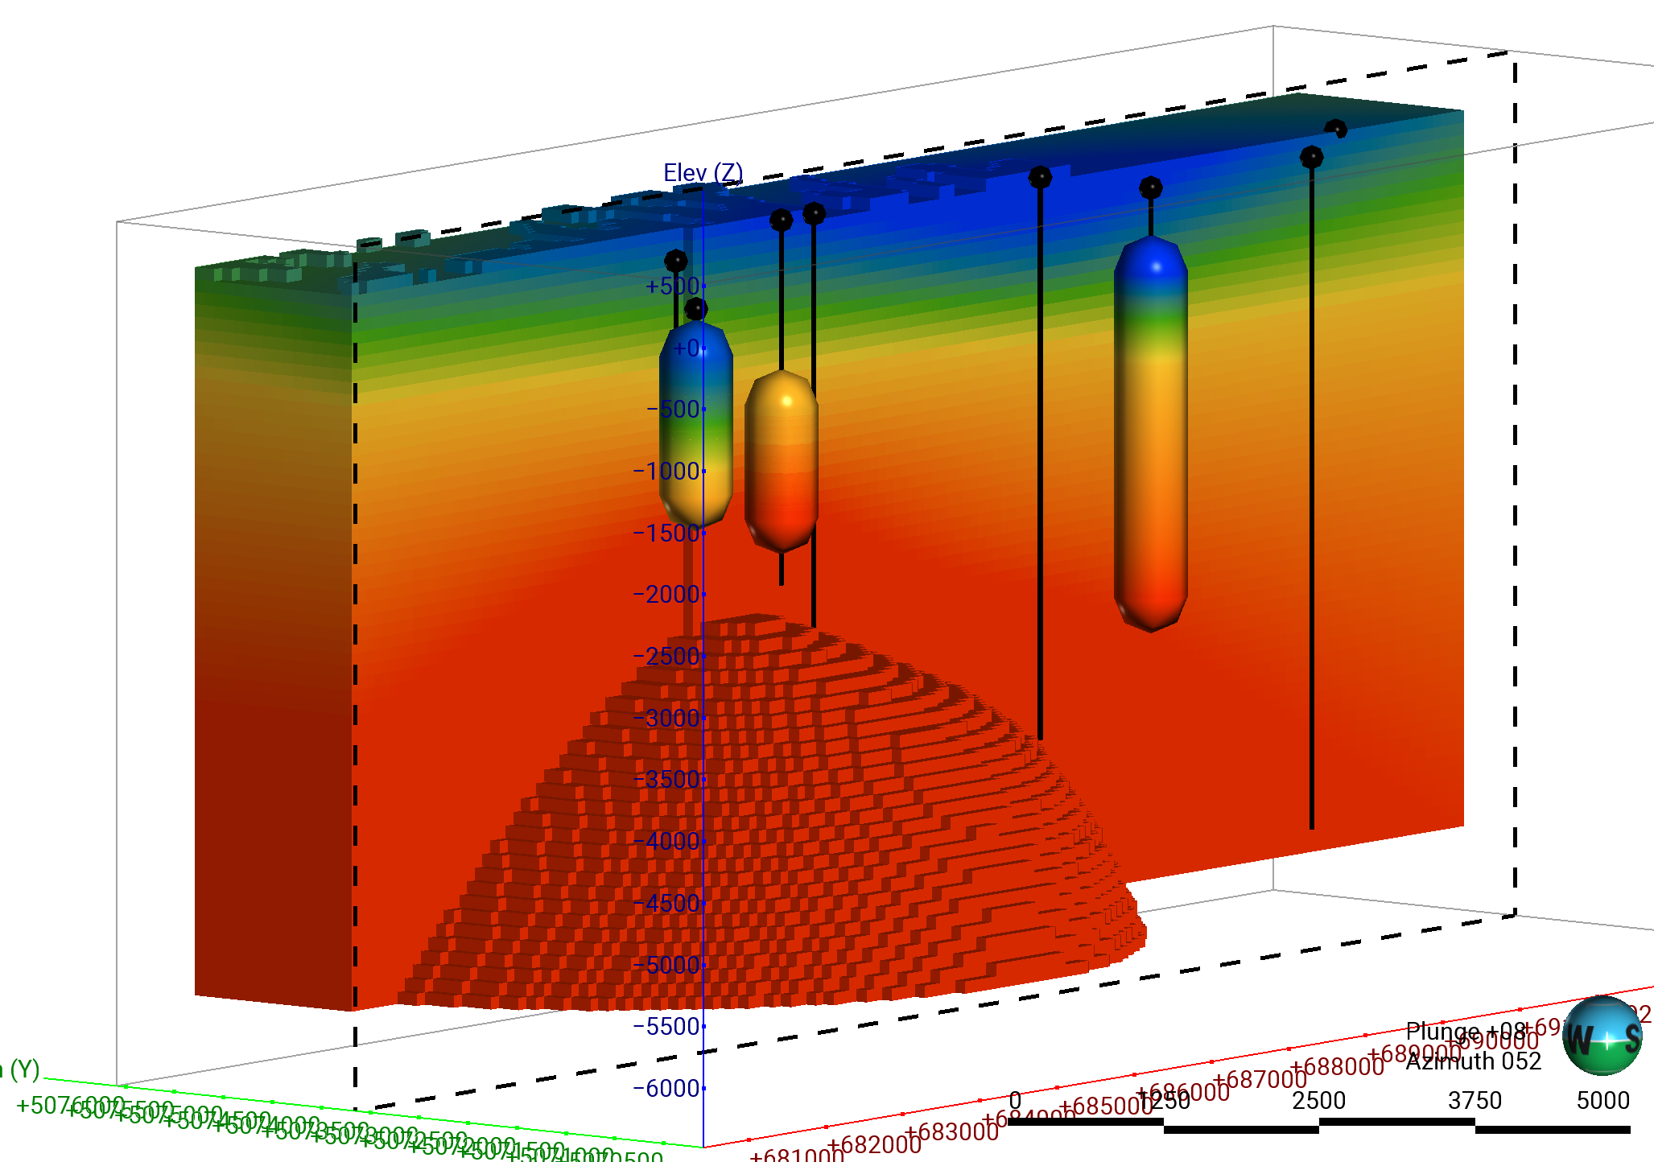
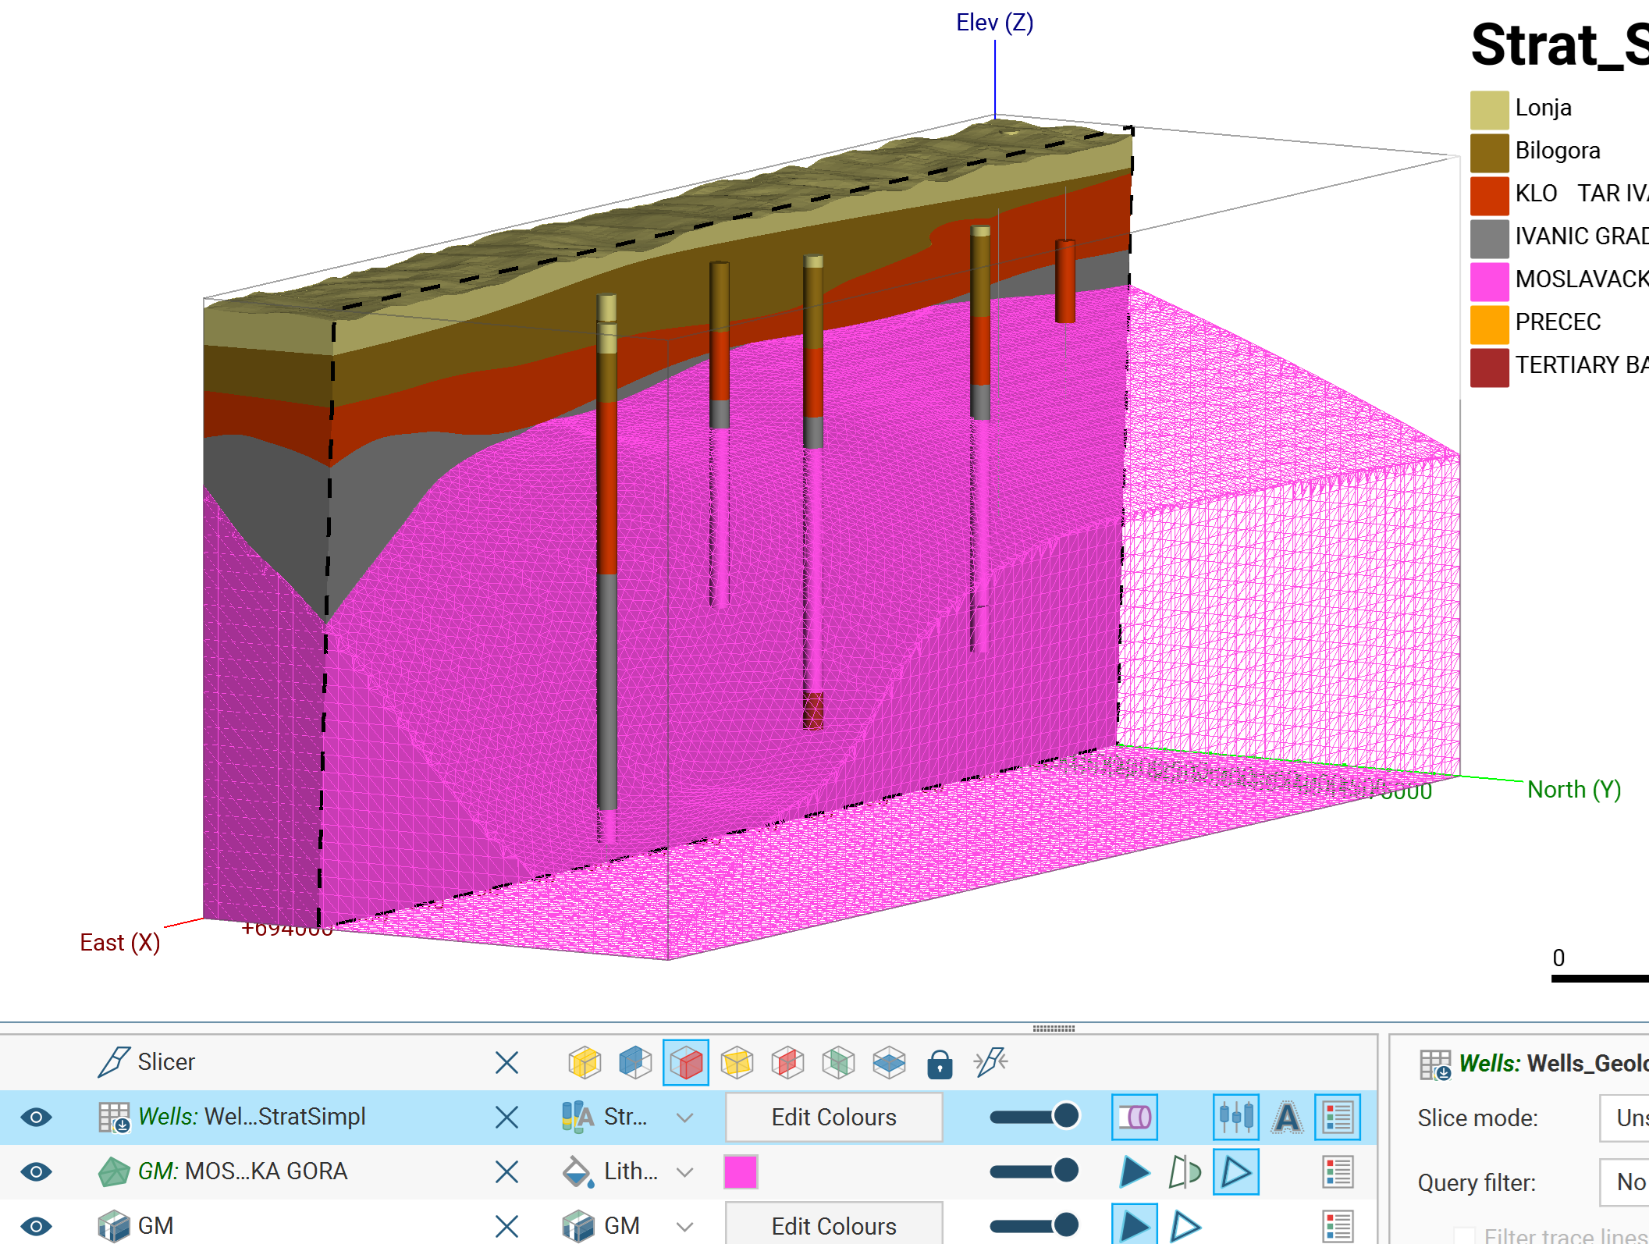
Interpretation (Leapfrog)
9

Slide 10
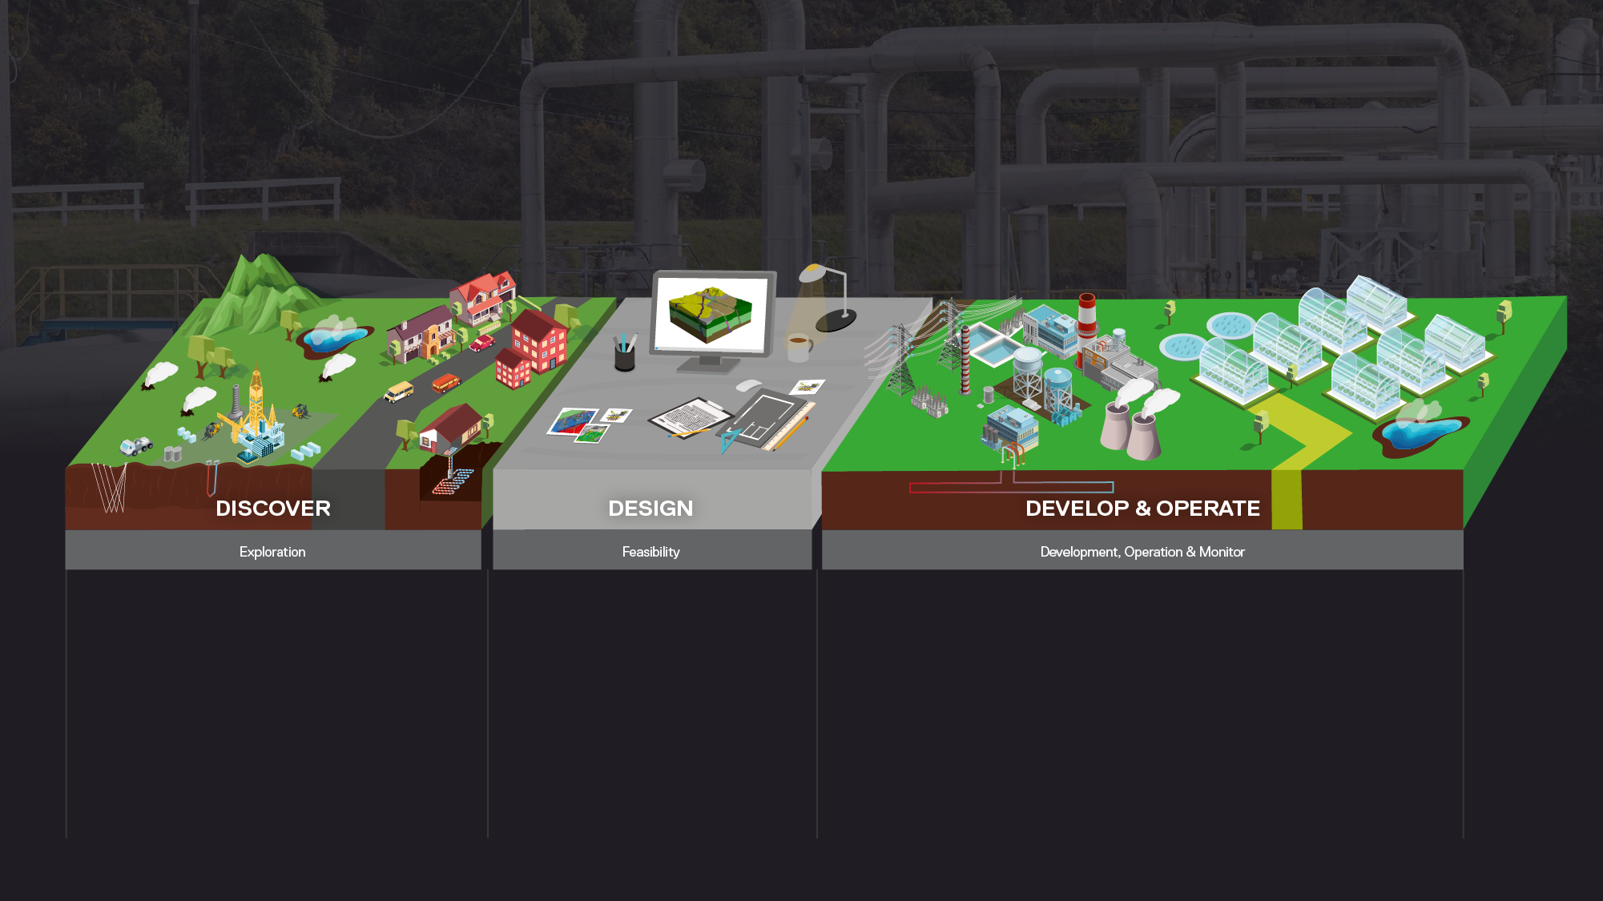







Geothermal
Communication
Data Flow
Real-time Notifications
Collaboration
Web Visualisation
Cloud
/ GM-SYS / VOXI & Geophysics Modelling Solutions
/ Geothermal 3D Modelling Solutions
/ Data & Model Management Solutions

Slide 11

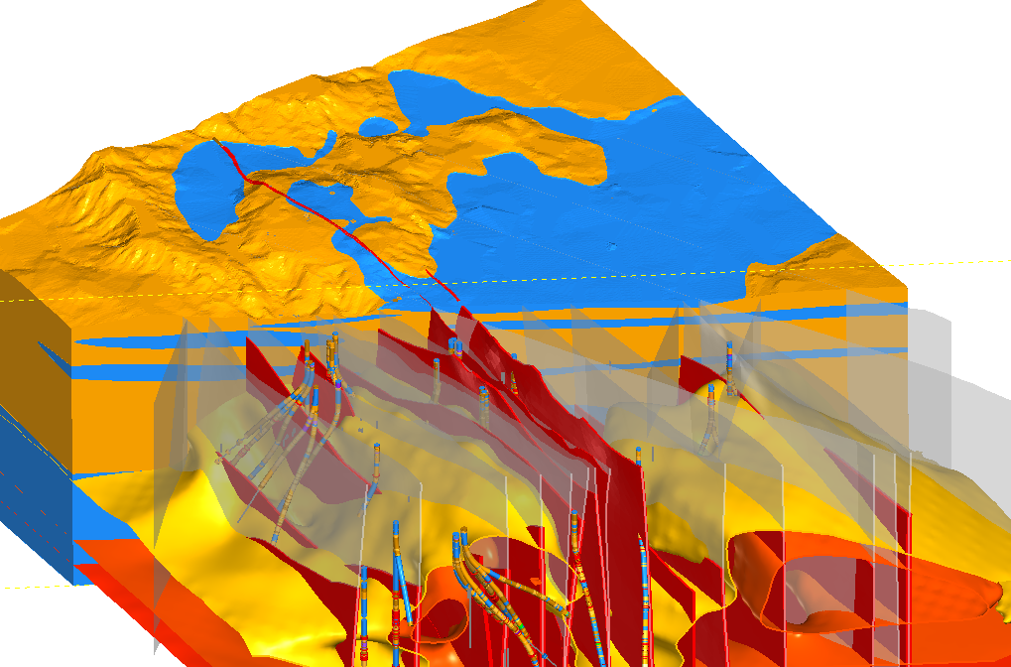
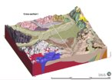
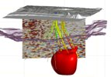
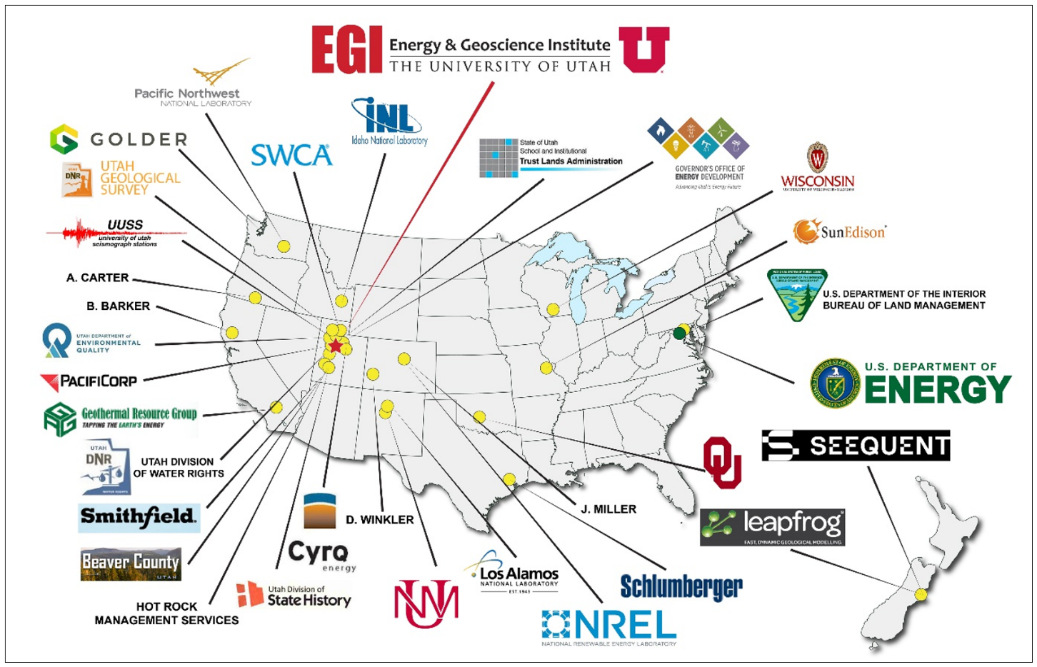
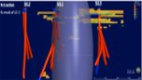
GLOBAL CASE STUDIES
ICELAND
SPAIN
JAPAN
USA
INDONESIA
Notes:
Established in 2004, 450+ staff, 18 offices round the world, enabling nearly 24 hour support to our customers.
HQ in Christchurch New Zealand.

Slide 12
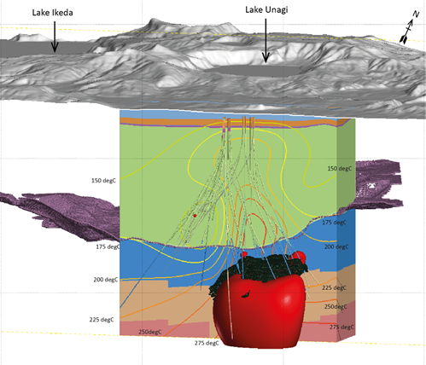
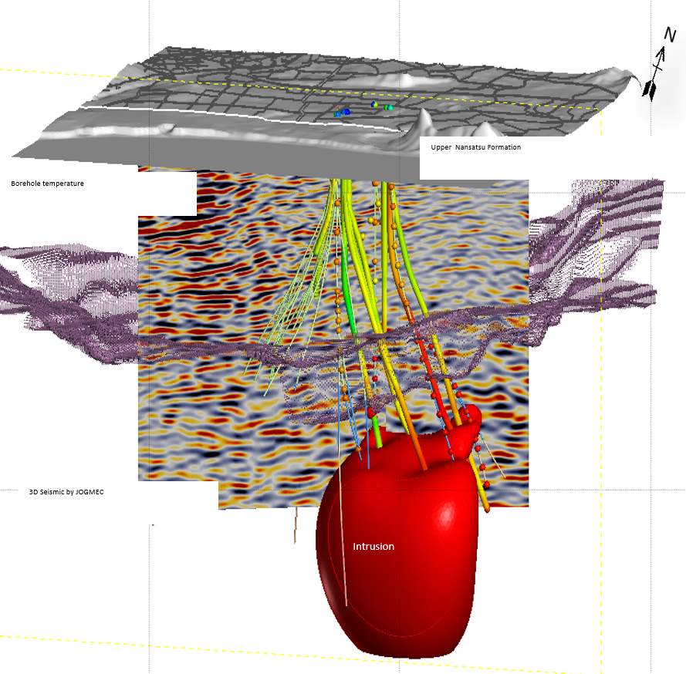
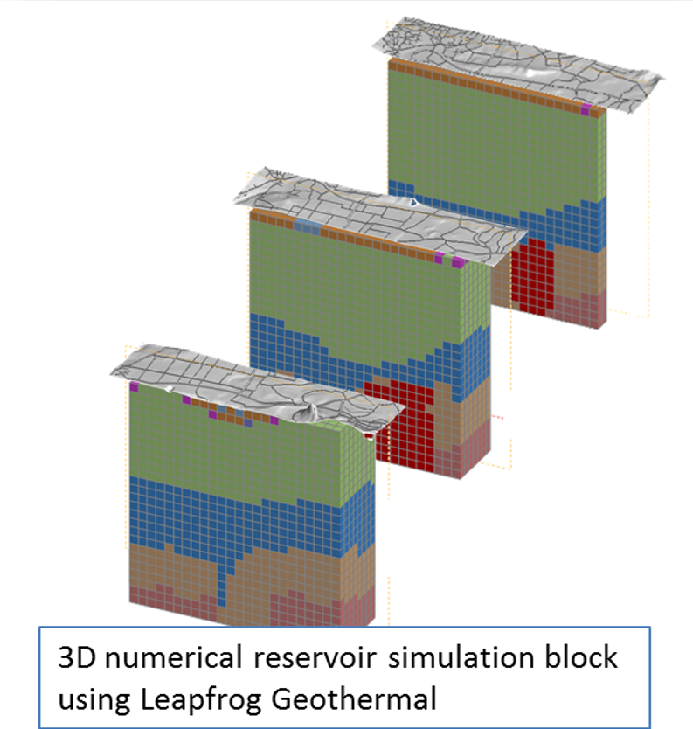
CASE STUDY: FIELD OPTIMISATION, YAMAGAWA, JAPAN
Leapfrog Geothermal used to integrate multiple datasets at the Yamagawa field in Japan:
Geology
MT
Seismic
Temperature
Alteration
The fast-modelling process was able to provide greater perspective on the reservoir including a large temperature inversion
3D seismic survey data used to constrain the top of important producing formation
The model was used to build the simulation grid for field forecasting purposes as a new binary powerplant was under construction
Wulaningsih et.al, 2017

Slide 13
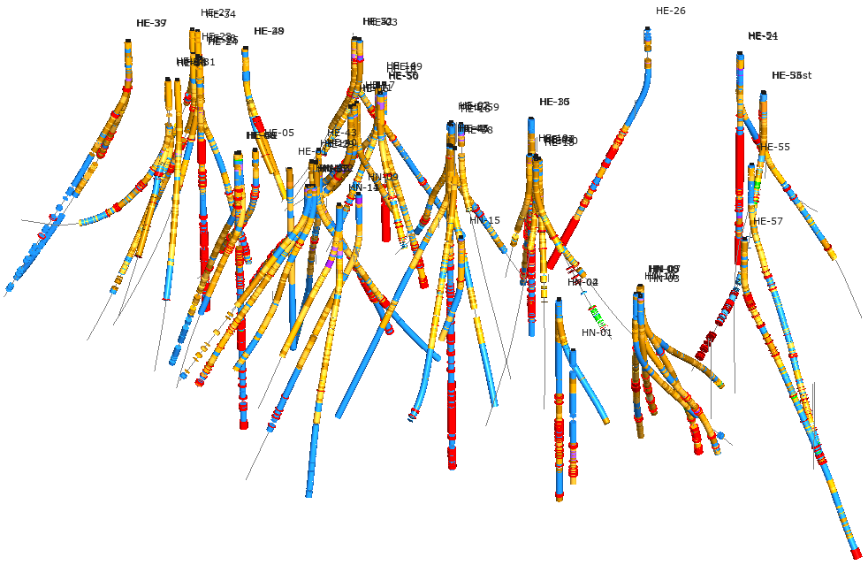
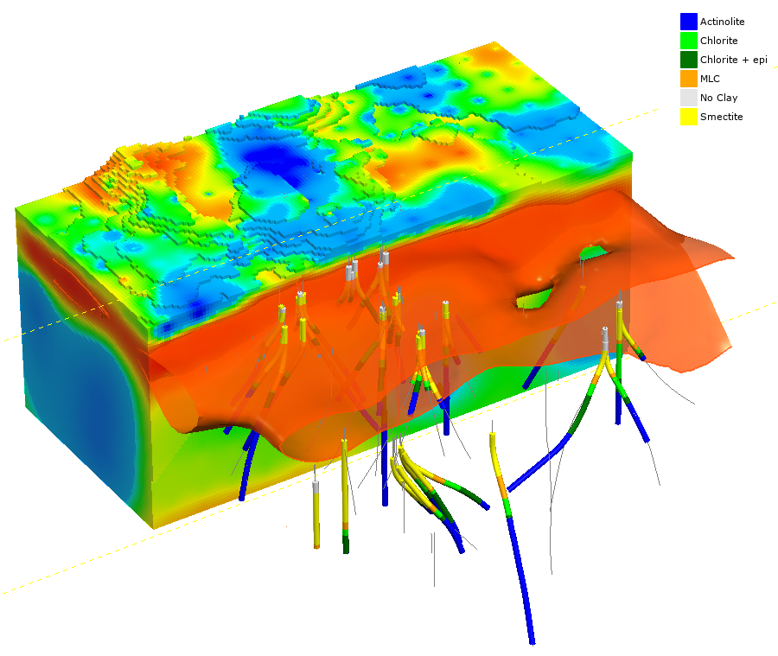
LARGE DATASET INTEGRATION, HELLISHEIDI, ICELAND
Leapfrog Geothermal application in Iceland for Reykjavik Energy
Integration of 30+ years of legacy data for about 70 deep wells including lithology, secondary mineralogy, geophysical logs and well design.
Good correlation between resistivity (MT) data and alteration mineralogy observed in the wells = clay cap
Better understanding of the resource using model combinations
Model used for well planning
Continuously updated with new well data
Version control with Central
Poux et.al, 2018

Slide 14
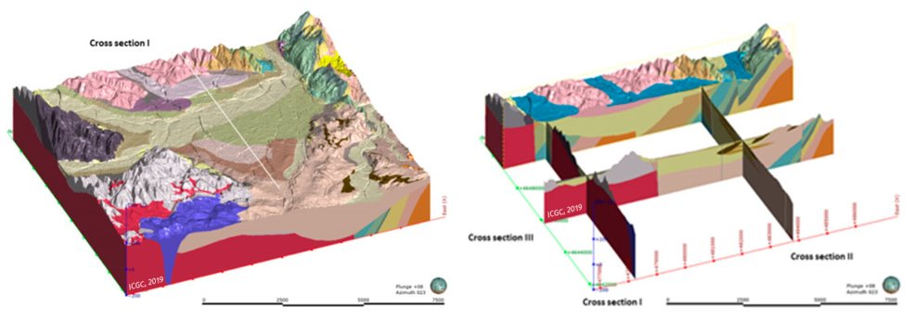
URBAN SHALLOW GEOTHERMAL ENERGY – CATALONIA, SPAIN
Regional scale conceptual model – focused on defining extent of sedimentary basin​
Data utilised was publicly available from surface, cross section, geophysics and borehole data.​
Next stage to input into FEFLOW model for resource assessment.
https://www.icgc.cat/Innovacio/Projectes-R-D-i/MUSE-GeoERA

Slide 15


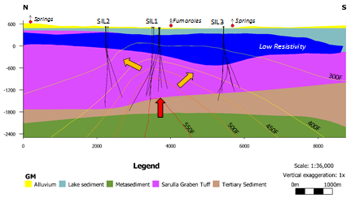
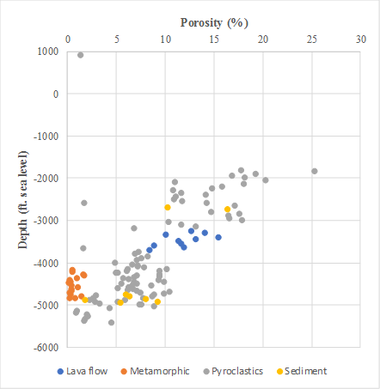
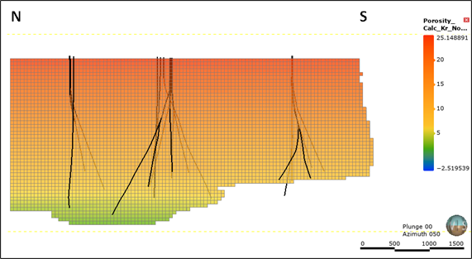
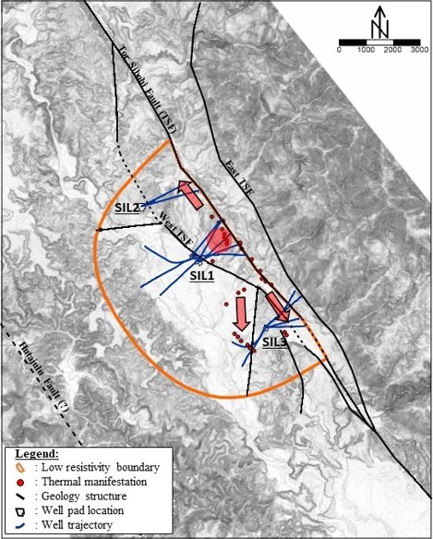
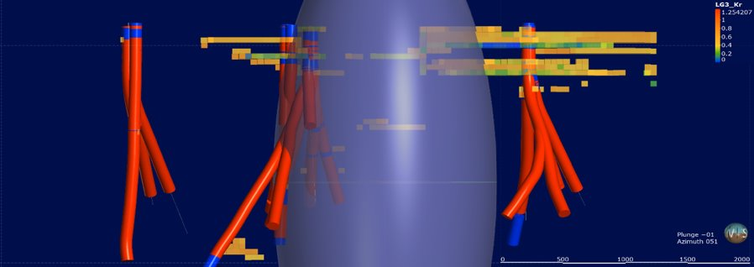
RESOURCE ESTIMATION, SILANGKITANG FIELD, NORTH SUMATRA, INDONESIA (SATYA, ET AL. 2020)
Conceptual Model
Data Analysis
Porosity Modelling
Facies Modelling
(Satya et al., 2018)

